Slide 1
BBIT121/CISY110
Introduction to Programming
Control Structures in C++

Slide 2
Introduction
Control Structures are just a way to specify flow of control in programs.
Any algorithm or program can be more clear and understood if they use self-contained modules called as logic or control structures.
It basically analyzes and chooses in which direction a program flows based on certain parameters or conditions.
Three basic types of logic, or flow of control, known as:
Sequence logic, or sequential flow
Selection logic, or conditional flow
Iteration logic, or repetitive flow

Slide 3
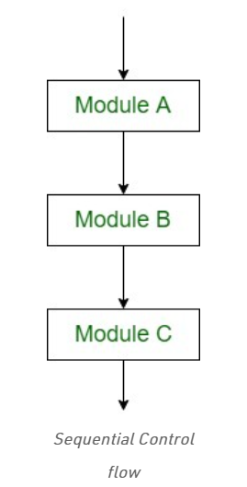
Sequential Logic (Sequential Flow)
The flow depends on the series of instructions given to the computer. Unless new instructions are given, the modules are executed in the obvious sequence.
The sequences may be given, by means of numbered steps explicitly. Also, implicitly follows the order in which modules are written.

Slide 4
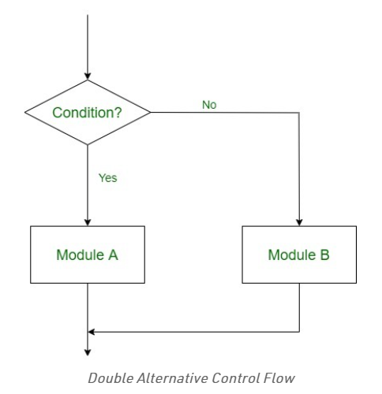
Selection Logic (Conditional Flow)
This involves a number of conditions or parameters which decides one out of several written modules.

Slide 5
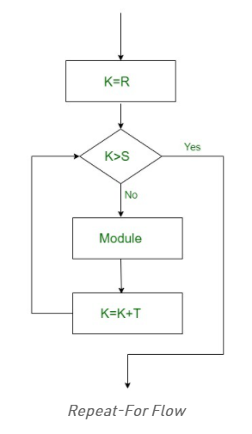
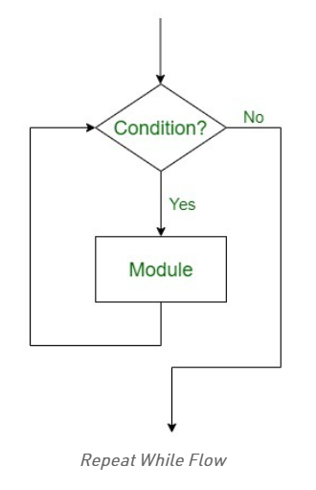
Iteration Logic (Repetitive Flow)
This employs a loop which involves a repeat statement followed by a module known as the body of a loop.

Slide 6
Selection control structures in c++
C++ provides us with 4 control structures that we could implement for selection flow of control:
if statement – click here for syntax and example
if….else statement - click here for syntax and example
nested if statement - click here for syntax and example
switch…case statement - click here for syntax and example

Slide 7
Iteration/repetition/loop control structures
Repetition structures, or loops, are used when a program needs to repeatedly process one or more instructions until some condition is met, at which time the loop ends.
The process of performing the same task over and over again is called iteration, and C++ provides built-in iteration functionality.
A loop executes the same section of program code over and over again, as long as a loop condition of some sort is met with each iteration.
Two types of repetition structures: pretest and posttest loops Pretest:
Loop condition appears at beginning of pretest loop
Determines number of times instructions w/in loop body are processed
Types of pretest loop:
While: click here for syntax and example
For: click here for syntax and example
Posttest:
Loop condition appears at end of posttest loop
Determines number of times instructions w/in loop body are processed
HOWEVER, instructions processed at least once--the first time!
Types of posttest loop:
do...while: click here for syntax and example

Slide 8
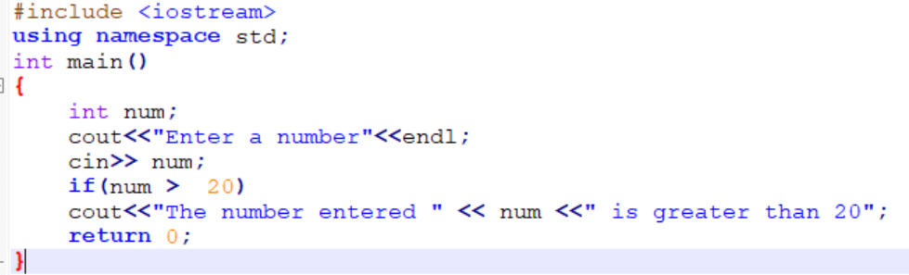
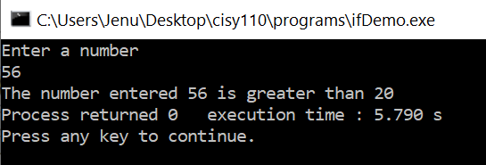
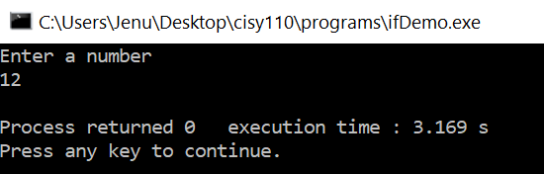
If statement
Syntax:
if(condition)
{
//block of statements to be executed if the condition is true
}
Program Example:
Output with user first entering a number 56 and the second run entering the number 12:
Back

Slide 9
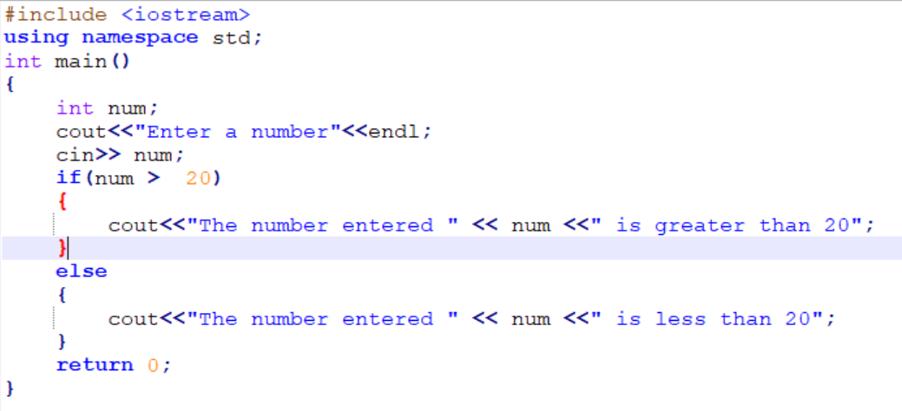
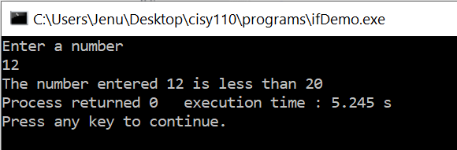
If..else statement
Syntax:
if(condition)
{
//block of statements to be executed if the condition is true
}
else
{
//block of statements to be executed if the condition is false
}
Program Example: Output:
Back

Slide 10
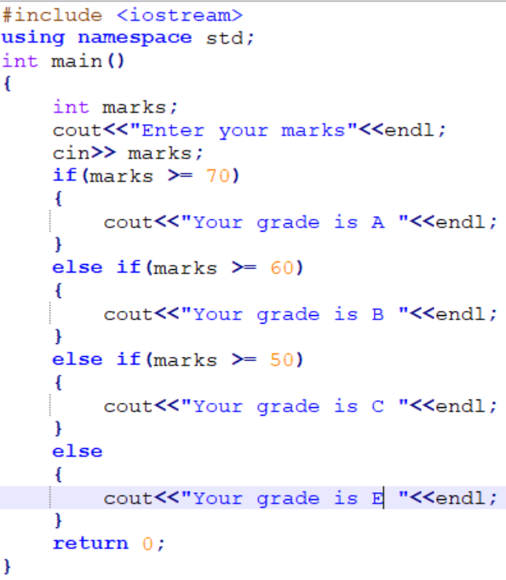
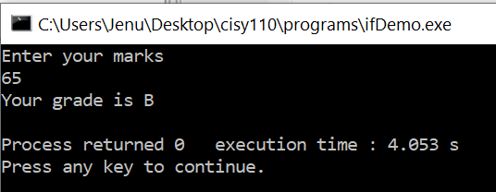
Nested if statement
Syntax: Program Example:
if(condition)
{
//block of statements to be executed if the condition is true
}
else if(condition2)
{
//block of statements to be executed if the condition 2 is true
}
….
else if(conditionN)
{
//block of statements to be executed if the condition N is true
}
else
{
//block of statements to be executed if the all condition are false
}
Output:
Back

Slide 11
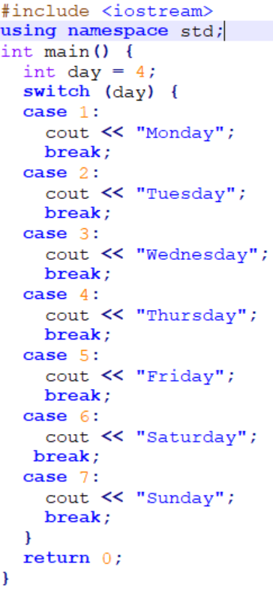
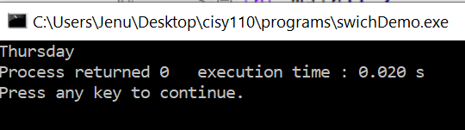
Switch...case statement
Syntax: Program Example:
switch(expression)
{
case x:
// code block
break;
case y:
// code block
break;
default:
// code block
}
Note:
The switch expression is evaluated once
The value of the expression is compared with the values of each case
If there is a match, the associated block of code is executed
The break and default keywords are optional
Output:
Back

Slide 12
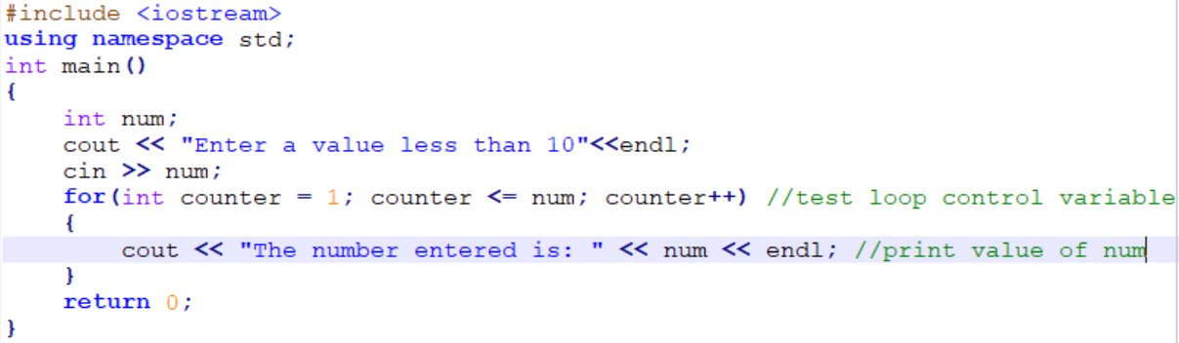
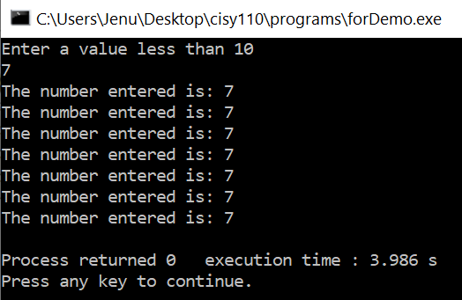
For loop
Syntax:
for (initial statement; test statement (loop condition); update statement)
{
//block of statements to be executed
}
Program Example: Output:
Back

Slide 13
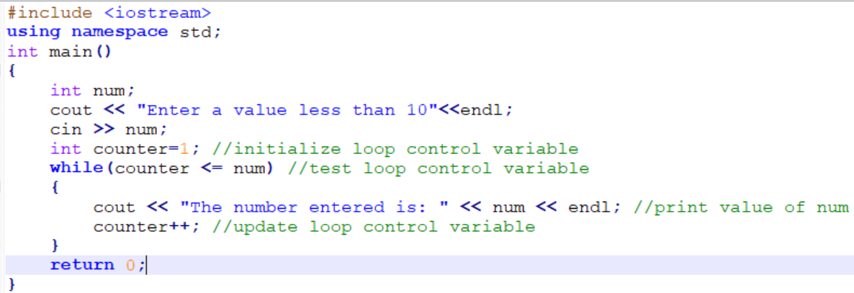
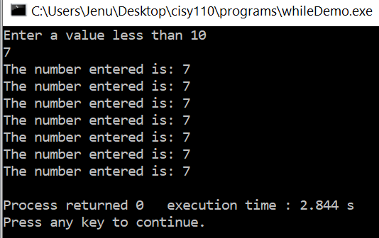
While loop
Syntax:
while (expression)
{
//block of statements to be executed in the expression/condition is true
}
Program Example: Output:
Back

Slide 14
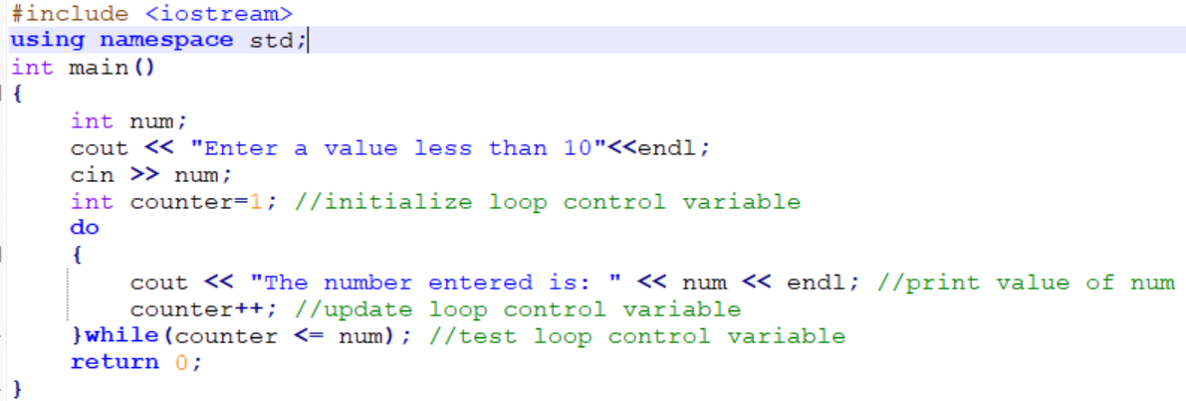
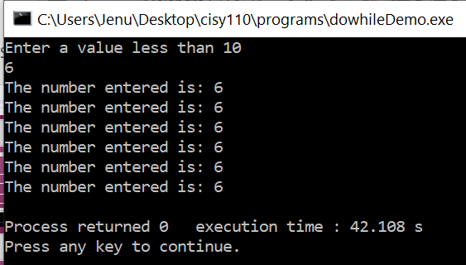
Do..while loop
Syntax:
Do
{
//block of statements to be executed
}while (expression);
Program Example: Output:
Back

